Slide 1


Slide 2
Cervical Conization
Dr.Yousefi
Professor OF Mashhad University of Medical Sciences
Gynecologist Oncologist

Slide 3
Cone Biopsy is a surgical procedure with removal of a cone shaped portion of the cervix
The extent of involvement of epithelium on the ectocervix has been clearly demarcated by colposcopy
Lugol's iodine solution aids in this determination

Slide 4
The endocervical canal is sounded to guide the direction and depth of the excision
This incision does not need to be circular but should accommodate excision of all atypical epithelium

Slide 5
The extent of excision must be adjusted according to individual needs
A small amount of normal tissue around the cone-shaped wedge of abnormal tissue is also removed so that a margin free of abnormal cells is left in the cervix

Slide 6
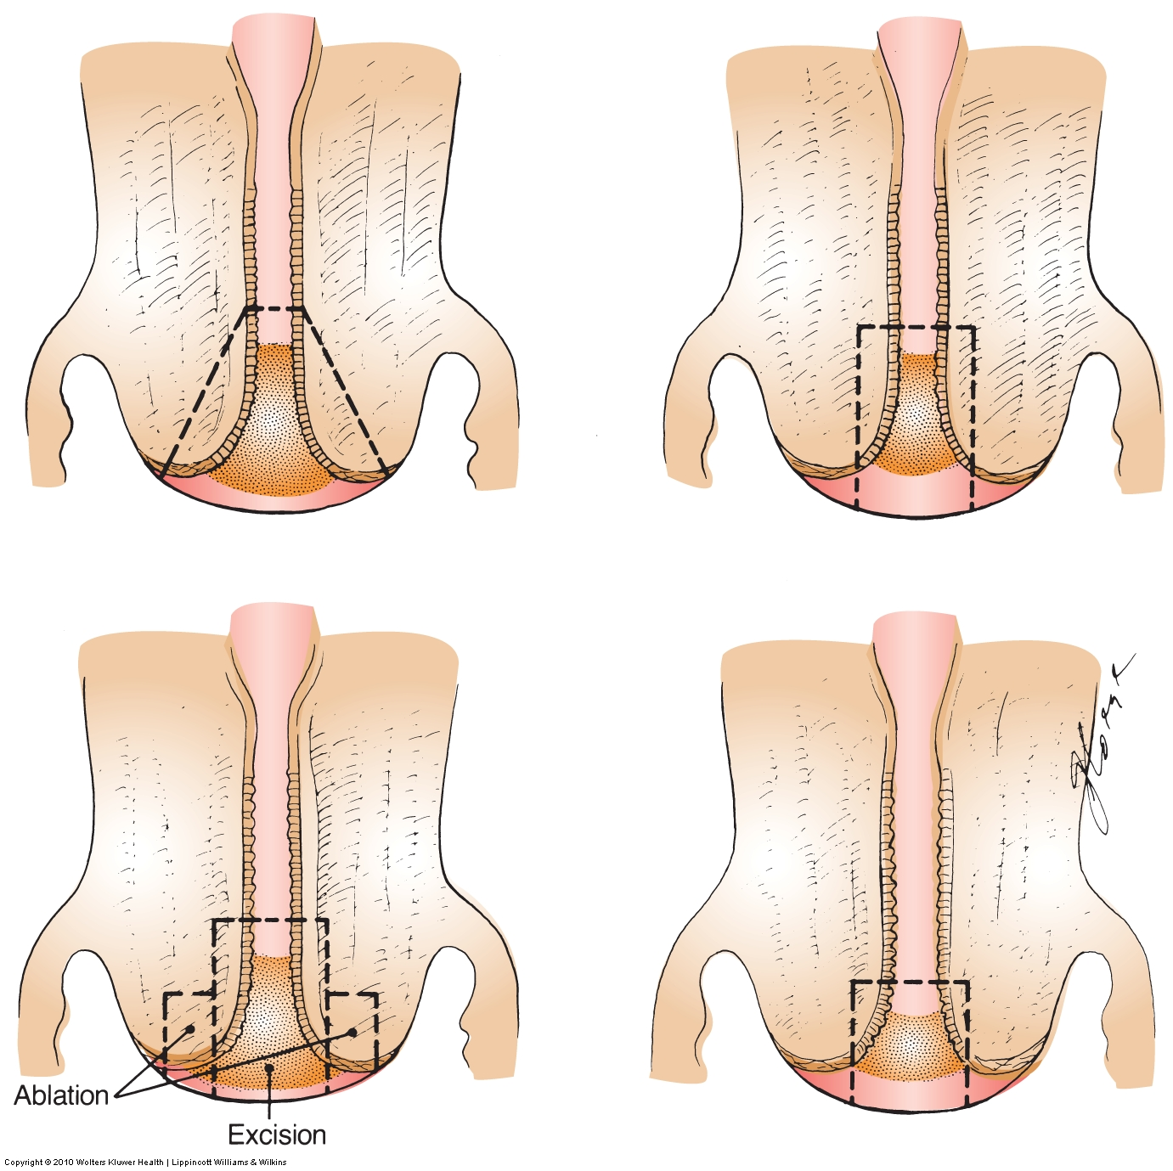

Slide 7
The excised specimen is tagged at the 12 o'clock position using suture to allow for
proper orientation by the pathologist
conization can provide more exact pathological information particularly
in the evaluation of CIN grading
and stromal invasion

Slide 9
High endocervical involvement fairly accurately is possible
Obtaining cytology specimens
by performing endocervical curettage
or by with an endocervical brush

Slide 10
A fractional curettage of the
endocervical canal
and endometrium
to exclude residual squamous
or glandular disease
of the upper endocervical canal
or of the endometrium

Slide 11
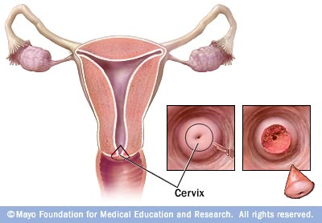

Slide 12
The base of the surgical site maintain hemostasis can be cauterized to or hemostatic sutures
The traditional Sturmdorf sutures are not advisable because of the risk of burying residual disease
Simple U-sutures placed
anteriorly and posteriorly
may be used if bleeding persists

Slide 13
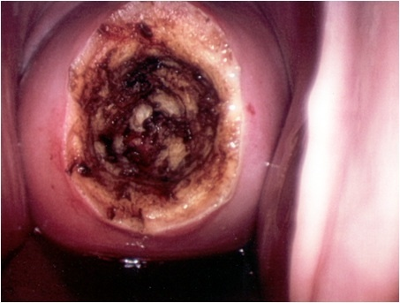

Slide 14
Indications conization:
(ASCCP) American Society for Colposcopy and Cervical Pathology issued
Conization may be used either for diagnostic purposes or
for therapeutic purposes to remove pre-cancerous cells

Slide 15
Indications for Diagnostic conization
1.The lesion cannot be fully visualized
2.The ECC is positive
3.There is significant discrepancy between the Pap smear and biopsy
4.A biopsy reveals microinvasive squamous cell carcinoma
5.A biopsy reveals adenocarcinoma in situ

Slide 16
Finding epithelial cell abnormalities in the
absence of gross
or colposcopic lesions of the cervix
HSIL ( CIN II / CIN III )
Unsatisfactory colposcopy
  AGUS

Slide 17
Therapeutic conization:
Treatment of cervical cytological abnormalities
CIN grades 2 and 3
Carcinoma in situ

Slide 18
Treatment issued :
Ablative or excisional
The excisional treatments include
(LEEP) conization Cold –knife conization
The ablative treatments
Electrocautery
Cold coagulation Cryosurgery
Laser

Slide 19
Types excisional conization include:
Cold knife conization
Usually outpatient, occasionally inpatient
loop electrical excision procedure (LEEP)
    Combined conization usually refers to a procedure started with a laser and completed with a cold-knife technique

Slide 20
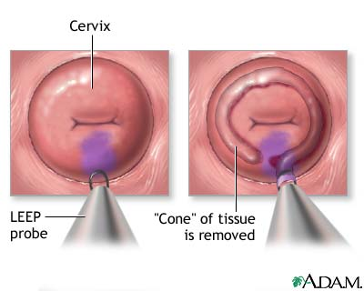

Slide 21
benefits and disadvantages
Cold-knife conization provides the cleanest specimen margins for further histologic study
but it is typically associated with more bleeding than laser or LEEP and
it requires general anesthesia in most cases

Slide 22
Laser procedures are of longer duration
if low-power density is used
may "burn" the margins
thus interfering with histological diagnosis
the high cost of the procedure
The main advantage with this procedure
dots produced by the laser energy can be used to accurately outline the exocervical margins

Slide 23
LEEP procedures have several advantages Including:
Rapidity
preservation of the margins for histological evaluation and virtual bloodlessness
can perform LEEP procedures in the office or in other outpatient settings

Slide 24
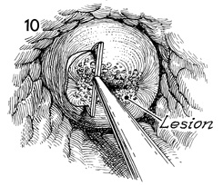

Slide 25
electro coagulation or cryosurgery
Are procedures that do not yield tissue for pathologic studies
their use should be limited to
those women in whom an accurate
preoperative diagnosis has been established by directed biopsy findings

Slide 26
Cold -knife conization :
Controversies exist as to
the necessity of removing the entire endocervical canal
including the internal os, in all cases

Slide 27
Conizaion treatment difficulties:
atrophy of the cervix post-menopausal
patients not easily observed transformation zone is by colposcopy
there are increased conizaion treatment difficulties
Therefore, the effectiveness of the treatment of (CIN2 and CIN3) in post-menopausal women needs to be investigated

Slide 28


Slide 29
Side effects of the conizaion may include:
cervical stenosis with resulting hematometra (collection of blood in uterus)
Intraoperative
or postoperative bleeding

Slide 30
If bleeding is heavier and does not settle quickly hemostasis using Monsel's solution
Rarely, sutures may be required
Infertility Uterine perforation
Anesthetic risk
increase the risk of incompetent cervix
Pregnancy loss and Preterm birth

Slide 31
Prophylactic cervical cerclage
Did not prevent preterm delivery
The cerclage may itself be a risk factor for preterm delivery
Sutures can act as a foreign body
which may cause uterine irritability
And lead to contractions after
a cerclage procedure

Slide 32
Main cause of treatment
failure conization :
Risk factors of positive margins
A larger lesion area
Menopausal status
Carcinoma in situ
LEEP

Slide 33
Risk factors for recurrent isease:
Age
cytology grade
Menopause status
Margin involvement
HPV genotype
HPV viral load
Have all been observed as risk factors
In CIN treatment

Slide 34
Decrease of risk factors for
residual/ recurrent disease after conization
Cytology or curettage specimen
immediately after conization
(glandular involvement)

Slide 35
Predicting the persistence
of HPV in CIN after conization
HPV genotype 16
And margin status

Slide 36
Restrictions after this procedure?
Avoid any activities that require concentration for two days
(i.e. driving a car, because some medications may make drowsy or dizzy)
Avoid swimming in public swimming pools for about 3 weeks
Return to work 5-7 days after surgery

Slide 37
After a cone biopsy
Some vaginal bleeding is normal for up to
1 -2 weeks
Some vaginal spotting or
discharge (bloody or dark brown)
may occur for about 3 weeks
Sexual intercourse should be avoided
for about 3 weeks
Douching should not be done for about 2- 3 weeks

Slide 38
Cervical conization
achieves cure rates
for high-grade CIN
of in excess of 95% of cases

Slide 39
Several reasons for the
absence of residual dysplasia in LEEP specimens despite
of dysplasia is identified
by colposcopic biopsy
(16.4% - 17.7%)

Slide 40
First, the CIN lesion is focal and small and removed completely by punch biopsy
Second, the remaining small lesion after punch biopsy may undergo spontaneous regression
Third, CINs are missed and not removed by LEEP Residual disease during follow-up
Fourth, the wrong pathological report can be obtained fail pathologist to observe the area that contained the CIN
Close follow-up of cases with no dysplasia in LEEP specimens is still needed

Slide 41
Follow-up after conization:
Repeat Pap smears
and colposcopy should be performed
at 6 and 12 months post treatmen

Slide 42
After several normal Pap test
the patient may return to
annual screenin
particularly if a high risk HPV DNA test
is negative

Slide 43

Thank you

